Slide 1
Jumping events development from beginners to senior athletes
Piotr Bora

Slide 2
Planning of training programs is
the primary responsibility of the coach

Slide 3
AGE till 14
Strength - sport games (strength)
start to teaching basic strength drills
shot throwing (medicine ball)
Speed - sport games (speed)
teaching special speed drills (skips A, B, C)
accelerations 20-40 m
Endurance - sport games
jogging

Slide 4
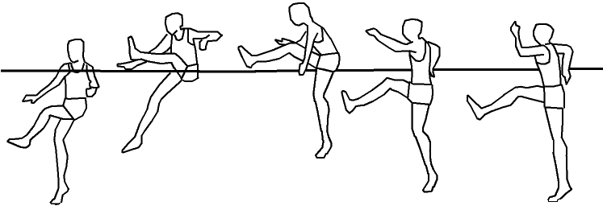
AGE till 14
Technique
High jump teaching basic technique (Scissor)
teaching el. of technique ( imitation of take off)

Slide 5
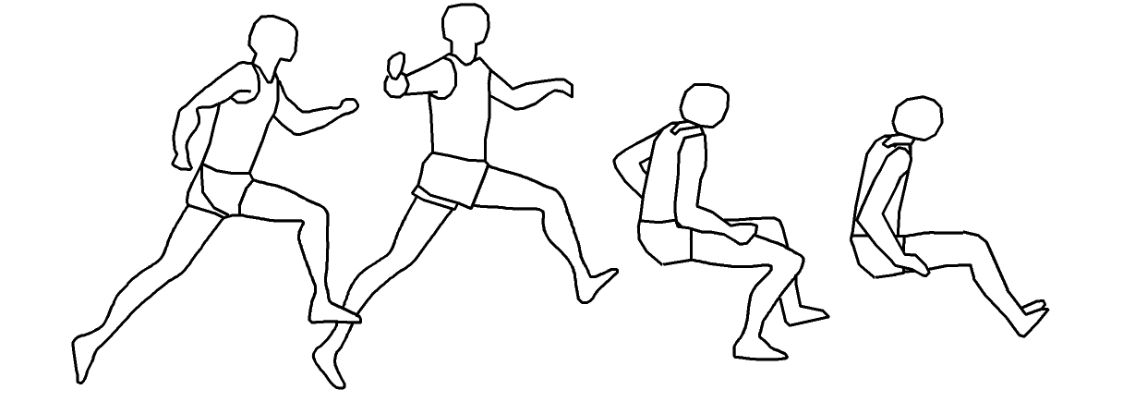
AGE till 14
Technique
Long jump teaching basic technique ( Sail)
teaching el. of technique ( imitation of take off)

Slide 6
AGE till 14
Technique
Triple jump
teaching multibounds (LL-RL)

Slide 7
AGE till 14
Jumping - sport games (jumping)
Flexibility - hurdle drills (walking)
No of training session - 2

Slide 8
AGE till 14
Competition - school, district, local
Sprints – 60m, 100m, 200m, 60m hurldes, 100/110m hurdles, relays
Jumps – long jump and high jump (basic technique)
Throwers – shot put (small loads), medicine ball, cricket ball
Multievents – (60m, long/high jump, cricket ball, 600m-girls/
1000m boys)

Slide 9
AGE 14-15
Strength - sport games (strength)
teaching basic strength drills
shot throwing
Speed – sport games (speed)
teaching special speed drills (skips A, B, C)
accelerations 20-40 m
Endurance – sport games
jogging
easy runs – distance 80-120 m

Slide 10
AGE 14-15
Technique
High jump - teaching Scissor technique teaching el. of technique ( imitation and rhythms of take off)

Slide 11
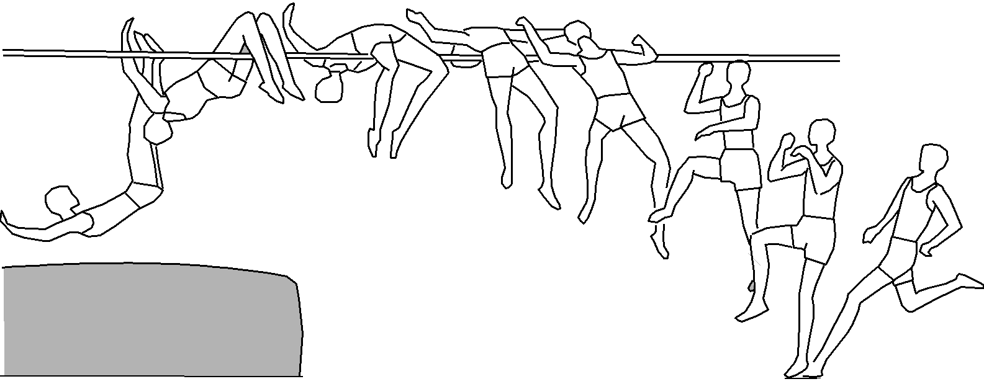
AGE 14-15
Technique
High jump - teaching Flop technique
special acrobatic drills
teaching el. of technique ( imitation and rhythms of take off)

Slide 12
AGE 14-15
Technique
Long jump - teaching technique (Sail)
teaching el. of technique ( imitation and rhythms of take off)

Slide 13
AGE 14-15
Technique
Triple jump - teaching mulitibounds ( LL-RL, LL, RL)

Slide 14
AGE 14-15
Jumping – sport games
teaching multibounds
Flexibility – hurdle drills (walking, skipping)
No of training session – 3

Slide 15
AGE 14-15
Competition - school, district, regional
Sprints – 60m, 100m, 200m, 60m hurldes, 100/110m hurdles, relays
Jumps – long jump and high jump (basic technique)
Throwers – shot put (small loads), medicine ball, cricket ball
Multievents – (60m, long/high jump, cricket ball, 600m-girls/
1000m boys)

Slide 16
Tab. 1 The example of the annual training plan – U-15

Slide 17
AGE 16-17
Strength - teaching basic strength drills
basic strength drills (small loads)
Speed – teaching special speed drills (skips A, B, C)
accelerations 20-40 m
run distance 40-60 m
Endurance – sport games
jogging
easy runs – distance 80-150 m

Slide 18
AGE 16-17
Technique
High jump - teaching technique (Flop)
special acrobatic drills
special drills (rhythms of take off)

Slide 19
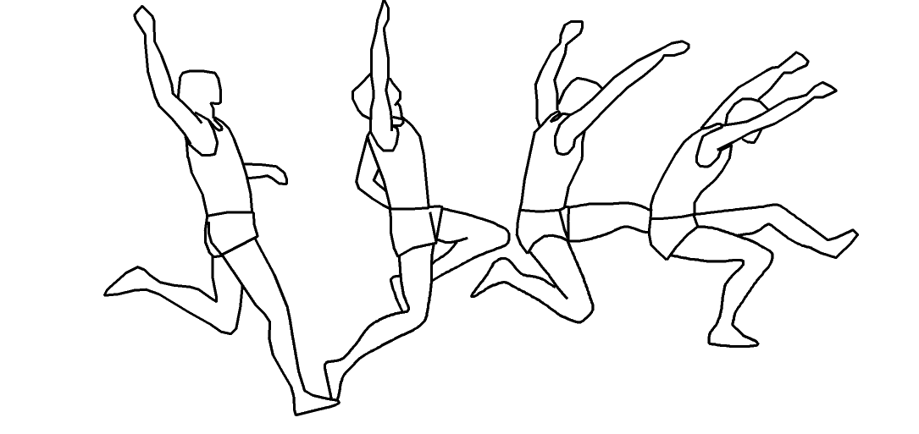
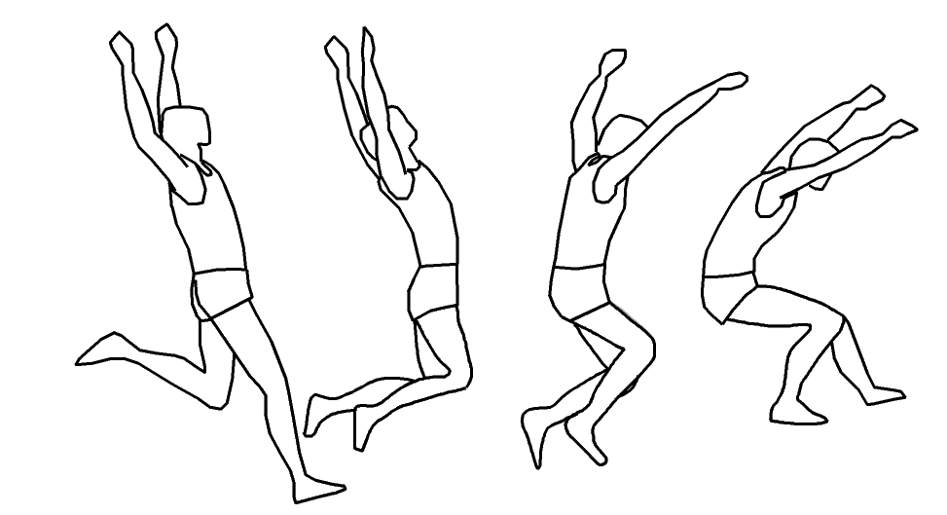
AGE 16-17
Technique
Long jump - teaching technique (Hitch-Kick or Hang)
special drills (rhythms of take off)

Slide 20
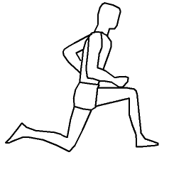
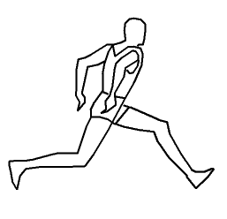
AGE 16-17
Technique
Triple jump - teaching basic technique (Single or Double Arm) and mulitibounds:
(LLL – RRRR, LLR-LLR)

Slide 21
AGE 16-17
Jumping – sport games
multibounds (LL-RL, LL, RL, LLLL-RLRL)
Flexibility – hurdle drills (walking, skipping)
No of training session – 3-4

Slide 22
AGE 16-17
Competition – regional, national, international
Sprints –100m, 200m, 100/110m hurdles, relays
Jumps – long jump, high jump and triple jump (basic technique)
Multievents – heptathlon – girls, decathlon - boys

Slide 23
Tab. 2 The example of the annual training plan – U-17

Slide 24
AGE 18-19
Strength - strength drills (small and medium loads)
Speed – accelerations 20-40 m
run distance 40-60 m
accelerations in curve 20-40 m (high jump)
Endurance – sport games
jogging
easy runs – distance 100-200 m

Slide 25
AGE 18-19
Technique
High jump - teaching technique (Flop)
special acrobatic drills
special drills (rhythms of take off)

Slide 26
AGE 18-19
Technique
Long jump - teaching technique (Hang or Hitch-Kick)
special drills (rhythms of take off)

Slide 27
AGE 18-19
Technique
Triple jump - teaching technique (Single or Double Arm)
special drills (multibounds)

Slide 28
AGE 18-19
Jumping – multibounds (LL-RL, LL, RL, LLLL-RLRL)
hurdle hops
plyometrics drills (small and medium loads)
Flexibility – hurdle drills (walking, skipping)
No of training sessions – 4-5

Slide 29
AGE 18-19
Competition – regional, national, international
Sprints –100 m, 200 m, relays
Jumps – long jump, high jump and triple jump
Multievents – heptathlon – girls, decathlon - boys

Slide 30
Tab. 3 The example of the annual training plan – U-19

Slide 31
AGE 20-23
Strength - strength drills (medium and high loads)
Speed – accelerations 20-40 m
run distance 40-60 m
accelerations in curve 20-40 m (high jump)
Endurance – jogging
run distance 100-200 m

Slide 32
AGE 20-23
Technique
High jump - Flop technique special acrobatic drills
special drills (rhythms of take off)
Long jump - individual technique:
(Sail, Hang, Hitch-Kick)
special drills (rhythms of take off)
Triple jump - individual technique:
(Single Arm, Double Arm)
special drills (multibounds)

Slide 33
AGE 20-23
Jumping – multibounds (LL-RL, LL, RL, LLLL-RLRL)
hurdle hops
plyometrics drills (medium and high loads)
Flexibility – hurdle drills (walking, skipping)
No of training sessions – 5-6

Slide 34
AGE 20-23
Competition – regional, university, national, international
Sprints – 100 m, 200 m, relays
Jumps – long jump and triple jump
high jump

Slide 35
Tab. 4 The example of the annual training plan – U-23

Slide 36
AGE over 23
Strength - strength drills (medium, high and maximum loads)
Speed – accelerations 20-40 m
run distance 40-60 m
accelerations in curve 20-40 m (high jump)
Endurance – jogging
run distance 100-200 m

Slide 37
AGE over 23
Technique
High jump - Flop technique special acrobatic drills
special drills (rhythms of take off)
Long jump - individual technique:
(Sail,Hang, Hitch-Kick)
special drills (rhythms of take off)
Triple jump - individual technique:
(Single Arm, Double Arm)
special drills (multibounds)

Slide 38
AGE over 23
Jumping – multibounds (LL-RL, LL, RL, LLLL-RLRL)
hurdle hops
plyometrics drills (high and maximum loads)
Flexibility – hurdle drills
No of training sessions – 5-8

Slide 39
AGE over 23
Competition – regional, university, national, international
Jumps – long jump and triple jump
high jump

Slide 40
Tab. 5 The example of the annual training plan – SENIOR

Slide 41
Thank you

